Slide 1
Stream Device Lab
Kay Kasemir,
based on material from Eric Norum
July 2026

Slide 2
Start “Simple Instrument”
Start demo device:
cd /ics/examples/07_stream/devices
python3 simpleInstrument.py --verbose
Access from other terminal, then try all the commands listed on next page:
nc localhost 24742

Slide 3
Test Example Device Commands
*IDN? Device Name (up to 100 chars long)
ON 0 Turn off
ON 1 Turn on
VOLTS 5.0 Set voltage, +-10V range
ON? Returns off/on state
VOLTS? Returns voltage setting
CURR? Returns current, +-11A
LOAD? Returns CPU load (1, 5, 15 minute average)

Slide 4
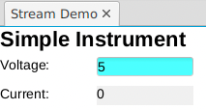
Study examples under /ics/examples/07_stream
Check demoApp/src/Makefile
  Adds asyn & stream support to IOC
Check demoApp/Db/si_stream.db, si.proto
  Records and protocol for the Simple Instrument
Check and run iocBoot/iocdemo/st_si.cmd
  IOC startup file
For display, use opi/simpleInstrument.bob

Slide 5
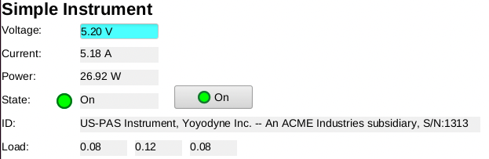
Support all Simple Instrument Commands
First, set units and increase the display precision.
Limit the voltage range to -10 .. +10 V.
Then add:
ON 0/1 - Allow turning the device off/on
ON? - Indicate the current device state
*IDN? - Display the device information
LOAD? - Display the CPU load of the device
Required steps likely include:
  Extend database and protocol file
  ‘make’
  Restart IOC
  Add to display

Slide 6
Hints
ON? replies with “ON 0” or “ON 1”
Use BI record with protocol similar to in "%d"
Set record fields ZNAM and ONAM to show as “Off”, “On” on display.
ON command needs “ON 0” or “ON 1”
Use BO record with protocol similar to out "%d"
Again set ZNAM and ONAM for display.

Slide 7
Hints
*IDN? Provides up to 100 chars
Use WAVEFORM record,
FTVL=“CHAR”, NELM=100,
with protocol based on in "%#s"
In display, use Text Update with Format: String.

Slide 8
Hints
LOAD? Replies with e.g. “0 0.01 0.05”
Use I/O Intr processing and value skipping (%*)
read_L1 { out ”LOAD?"; in "%f %*f %*f";}
read_L2 { in "%*f %f %*f"; }
.. same for L3
record (ai, “SI:Load1")
{
field (DTYP, "stream")
field (INP, "@si.proto read_L1 SI")
field (SCAN, "1 second")
}
record (ai, ”SI:Load2")
{
field (DTYP, "stream")
field (INP, "@si.proto read_L2 SI")
field (SCAN, "I/O Intr")
}
.. same for L3

Slide 9
More Ideas
Add a record to compute power = voltage * current
Your On/Off command should initialize by reading the current on/off state
What happens when you read the “*IDN” with “%s” instead of “%#s”?

